Slide 1
Git and source control basics
Mr. Wortzman
heavily adapted from git-scm.com/book

Slide 2
What is version control?
Version control is a system for keeping track of the changes made to a set of files over time.
Source control is version control for source code.
Benefits:
Easily revert back to a previous state
Track when changes were made to narrow down when an issue was introduced
Keep updates separate from one another

Slide 3
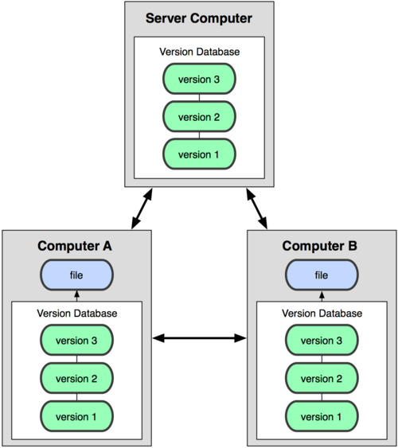

Distributed VCS
In a distributed version control system, all data is stored on all users’ local machine:
In a centralized version control system, in which users only have the data they are using:

Slide 4
git
Git is a distributed version control system developed by Linus Torvalds and others
Originally designed, and still used, to track work on the Linux kernel
Git has become one of the most popular version control systems in the world
Benefits:
Local operations (everything is done on your machine unless you need the server)
Snapshot storage (store entire files, not just changes)

Slide 5
Git terminology
Repository: A collection of files and the histories of those files.
Clone: A copy of a repository on another machine.
Branch: A parallel version of a repository in which edits can be made without affecting the main repository.

Slide 6
Git workflow
The basic workflow in Git is as follows:
Create a repository on the server
Clone the repository to your machine
(Optional) Create a branch
Edit some files in the repository, or add new ones
Stage the changes
Commit the changes to your local repository
Push the changes to the server
(Optional) Merge the changes to the main branch
(Optional) Delete your branch
Notes:
https://guides.github.com/introduction/flow/

Slide 7
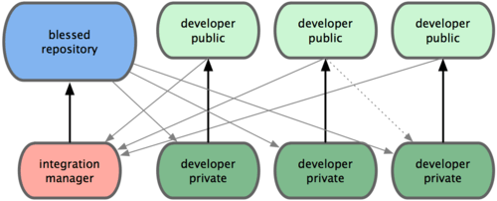
Git workflow
We will work with a variant of the integration manager workflow
Each of you will have a local repository in which you do your work (with any branches you want)
When your project is complete, you will submit a pull request to have your repository merged into the main class repository
This is submitting your project
Mr. Hawker or I will review the pull request and execute it if we believe the code is ready

Slide 8
Git/github demos

